Slide 1

BUDDHA INSTITUTE OF TECHNOLOGY GIDA , GORAKHPUR
Project Presentation
On
Job Recommender System
Using Hybrid Filtering
Presented by :
Astha Srivastava (2205251540021)
Shreya Pandey (2305251549010)
Ayushi Sonkar (2305251549002)
Under the Guidance of :
Dr. Shashank Srivastava
Hod,
CSE-Data Science

Slide 2
LIST OF CONTENT
Introduction
Literature review
Dataset Overview
Methodology
Result
Conclusion
Scope for future work
References

Slide 3
INTRODUCTION
Job Recommendation Systems Intelligent tools designed to assist users in finding suitable employment by analyzing job content, user preferences, and candidate profiles using ML and NLP techniques. | Need for Automation Manual search is inefficient and time-consuming Keyword-based engines lack contextual understanding Semantic analysis improves relevance.
HireHub Platform Web-based job recommendation system integrating content based filtering with popularity-based ranking for accurate, user centered recommendations. | Key Components User Query Processing Resume Parsing & Skill Extraction TF-IDF Based Matching Popularity-Based Ranking

Slide 4
LITERATURE REVIEW
Author & Year | Focus/Technique | Key Contribution | Limitation
Shrivastava et al. (2022) | Hybrid filtering | Combines content + collaborative methods | Requires structured user history
Martínez et al. (2021) | Profile-based hybrid model | Integrates professional profiles for matching | Limited to structured data
Chen et al. (2023) | HybridBERT4Rec | Uses BERT embeddings + collaborative filtering | High computational cost
Sharma et al. (2021) | TIMBRE framework | Scalable job recommendation using signals | Requires large user activity logs
Park et al. (2022) | Resume parsing | Learning-based skill extraction | Requires annotated training data
Verma & Xu (2023) | ML-based matching | Multi-stage extraction for candidate-job matching | Performance varies with resume quality
Lee & Kim (2023) | Systematic JRS review | Summarizes modern job matching strategies | Review-based, no experimental evaluation

Slide 5
DATASET OVERVIEW
DATASET SIZE
Rows: 315 rows (job listings)
Columns:10 columns (features)
DATASET SOURCE
Source: Kaggle
Dataset Name: LinkedIn Canada Data Science Jobs 2024
DATASET STRUCTURE
The dataset typically includes the following columns:
Column Name | Description
Job Title | Title of the job posting (e.g., Data Scientist, Data Analyst, ML Engineer).
Company Name | Name of the company offering the job.
Location | City or province within Canada where the job is located.
Job Type | Employment type (Full-time, Part-time, Contract, Remote, etc.).
Posted Date | The date when the job was posted.
Skills / Job Description | Required skills or responsibilities listed in the job post.
Seniority Level | Indicates whether the role is entry-level, mid-level, or senior, if available.

Slide 6
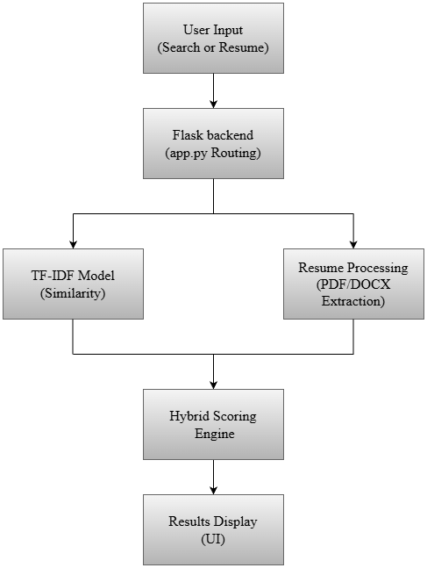
METHODOLOGY
Hybrid Filtering Approach for Job Recommendation
The system integrates Content-Based Filtering with Popularity-Based Ranking to deliver accurate, relevant, and user-centered job recommendations through both keyword search and resume-based matching.
1
TF-IDF Vectorization
Converts job descriptions into numerical vectors using term frequency analysis
2
Resume Processing
Extracts skills and keywords from PDF/DOCX resume files
3
Hybrid Scoring
Combines similarity scores with popularity metrics for balanced ranking
4
Results Display
Presents ranked job recommendations with detailed information

Slide 7
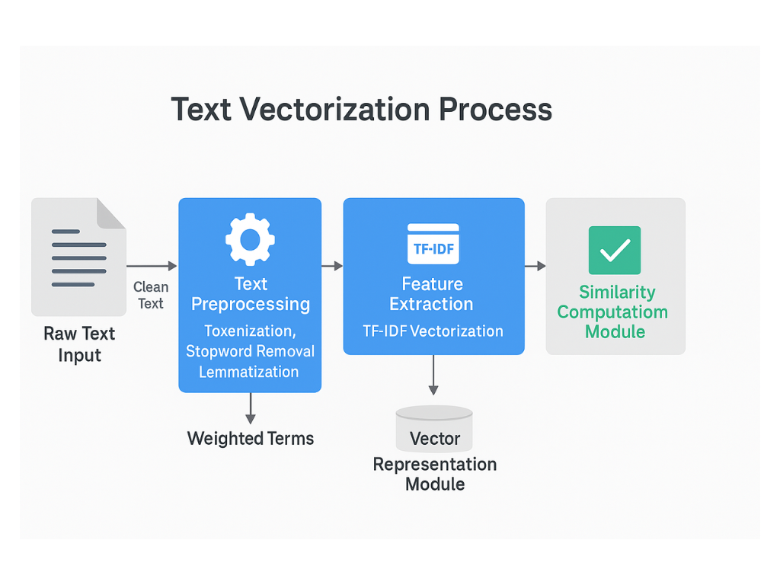
METHODOLOGY
TF-IDF Model & Text Preparation
Text Preprocessing
Merge job title, skills, and description
Remove special characters and noise
Convert to lowercase for uniformity
Handle missing values with fallback keywords
N-gram Vectorization
Unigrams, bigrams, and trigrams (1-3)
Max features: 10,000
English stopwords removed
Captures multi-word skills like "machine learning"
TF-IDF Matrix
Sparse matrix representation enables efficient cosine similarity computation for job matching
Vectorization Pipeline and Feature Extraction

Slide 8
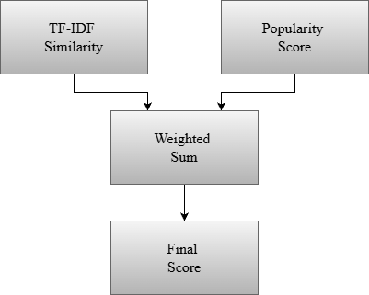
METHODOLOGY
Hybrid Recommendation Formula
Combining Content Similarity and Popularity
Key Features:
PDF/DOCX Support
Robust text extraction using PDFMiner, PyPDF2, and docx2txt
Skill Extraction
Dictionary-based keyword matching with regex patterns
Popularity Normalization
Log transformation prevents bias toward extremely popular jobs

Slide 9
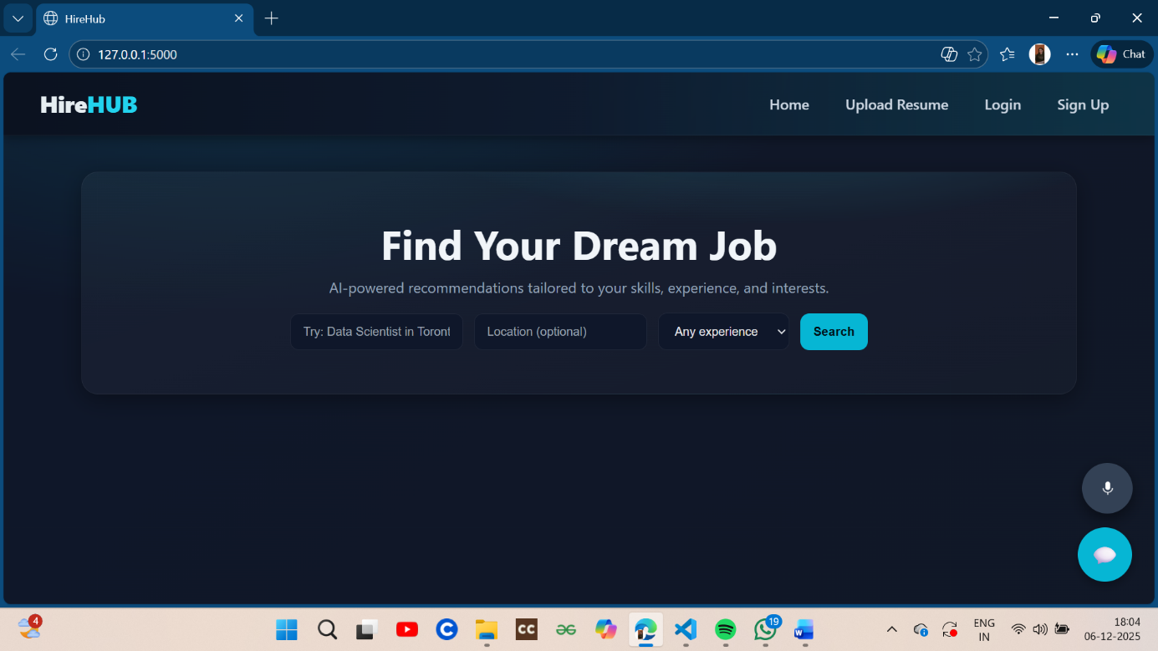
PROJECT OVERVIEW
Homepage of HireHub

Slide 10
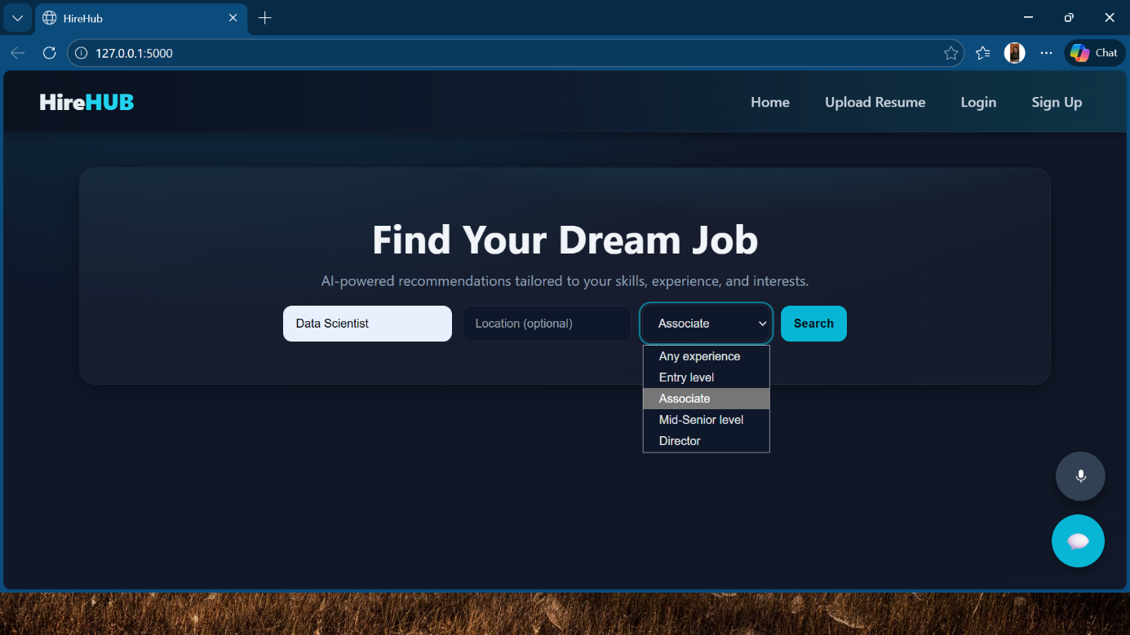
PROJECT OVERVIEW
Job Search Interface

Slide 11
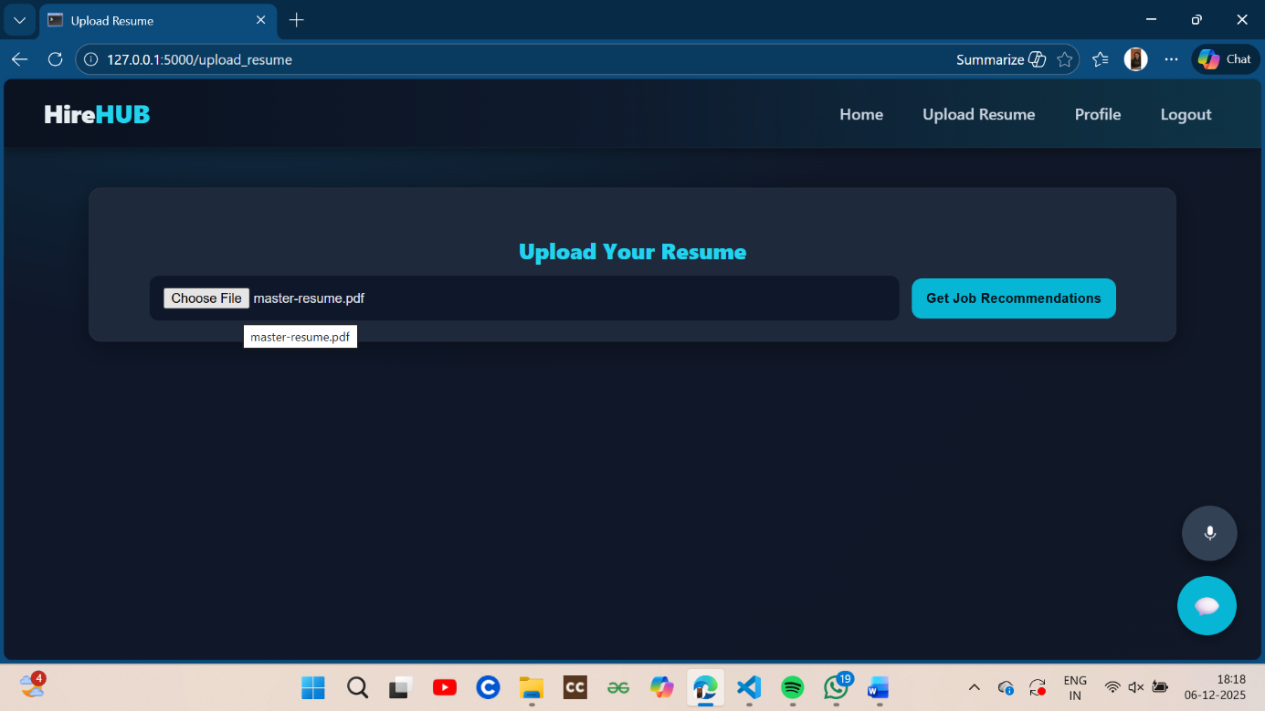
PROJECT OVERVIEW
Resume Upload Interface

Slide 12
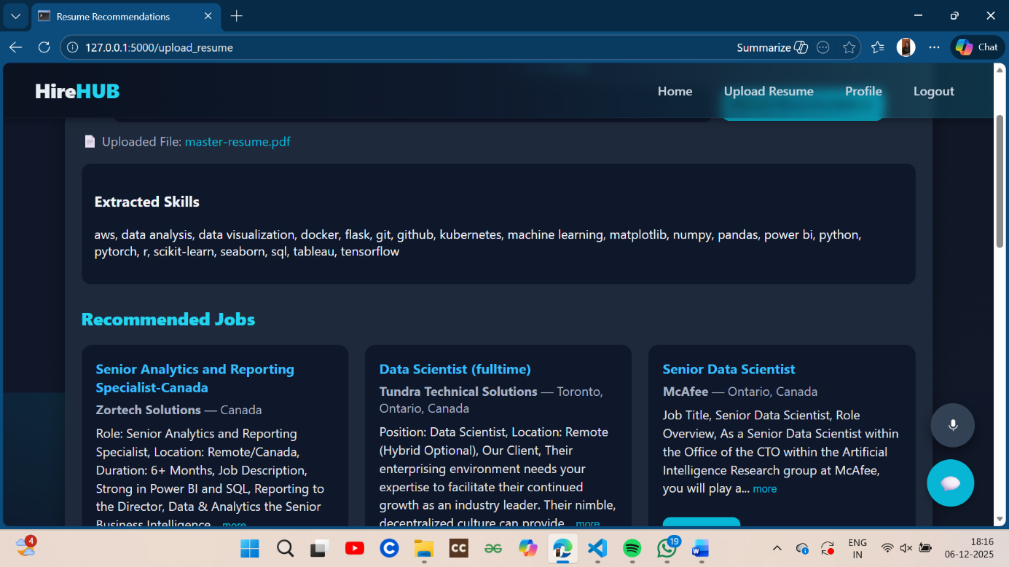
PROJECT OVERVIEW
Resume Based Recommendations

Slide 13
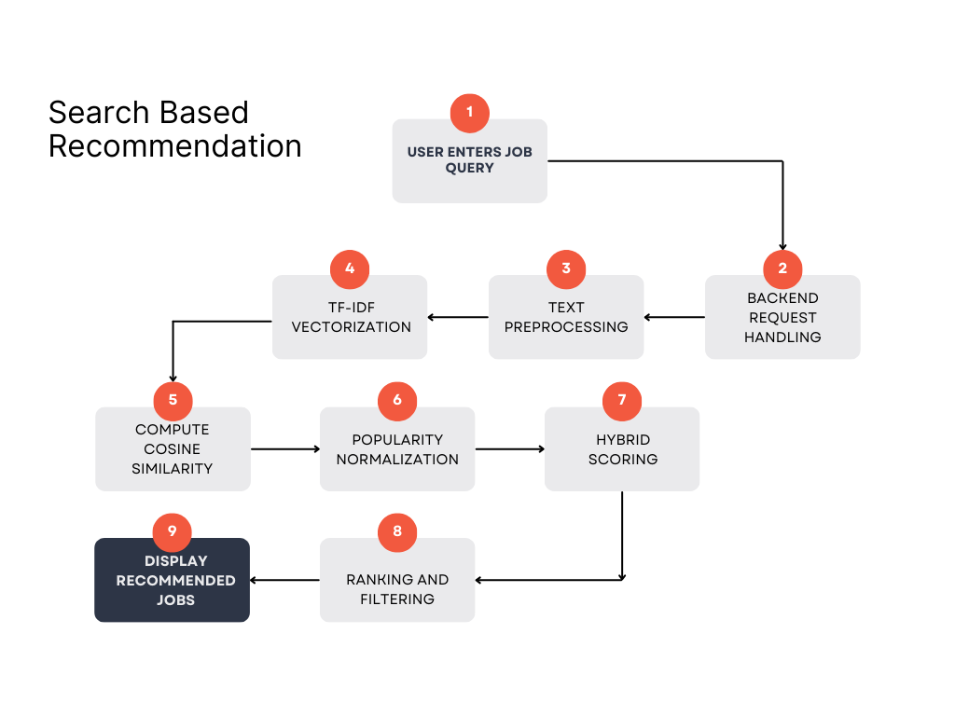
RESULTS
Recommendation Results
Search-Based vs Resume-Based Outputs
Example Query:
Role: Machine Learning Engineer
Location: Toronto
Experience: Entry-Level

Slide 14
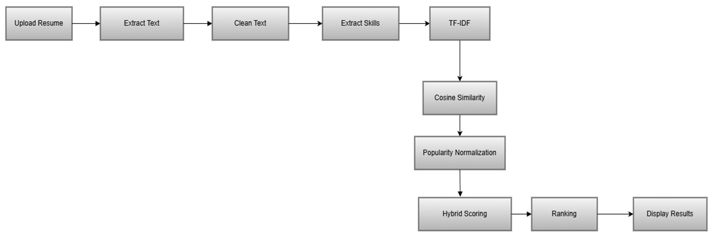
RESULTS
Extracted Skills Example:
Python, Machine Learning, TensorFlow, Data Cleaning, Statistics, SQL
Recommended Roles:
• Data Scientist
• ML Engineer
• Data Analyst
• Research Assistant (AI/ML)
• Deep Learning Engineer
Observation:
Resume-based mode provides highly personalized results for users who possess relevant skills but may not know exact job titles. Skill-based weighting delivers more accurate outputs than direct title matching.

Slide 15
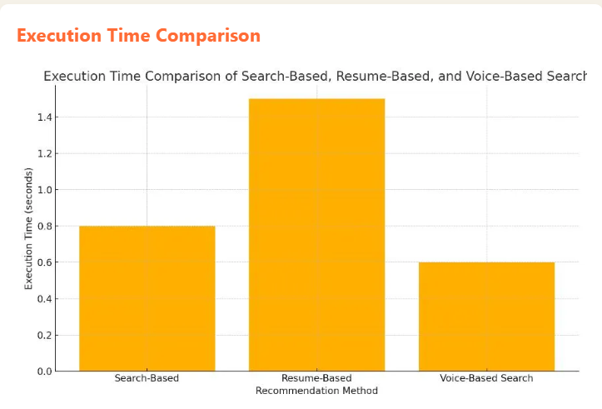
RESULT
Performance Analysis
System Efficiency and Score Distribution Metrics
Key Findings:
Efficiency
Consistent response times with precomputed TF-IDF matrix
Balance
Hybrid model prevents pure popularity bias
Scalability
Handles thousands of jobs with minimal
modifications
Query Execution Time
Search-based queries: 0.6-0.8 seconds
Resume-based queries: 1–1.6 seconds (delay due to PDF/DOCX parsing)
Voice-based queries: 0.4-0.6 seconds

Slide 16
CONCLUSION
Project Achievements
HireHub successfully demonstrates how AI, NLP, and machine learning can build an efficient job recommendation platform that bridges the gap between job seekers and suitable employment opportunities.
Key Components Integrated
TF-IDF vectorization for text similarity analysis
Resume parsing and skill extraction (PDF/DOCX support)
Hybrid recommendation logic combining relevance and popularity
Flask-based backend architecture with modular design
Interactive features: chatbot and voice search

Slide 17
SCOPE FOR FUTURE WORK
Technical Enhancements
ML Embeddings: Replace TF-IDF with BERT, Word2Vec, or Sentence Transformers for better contextual understanding
Real-Time Scraping: Integrate LinkedIn API, Indeed API for live job postings
Advanced Parsing: Incorporate deep learning for improved resume extraction
Collaborative Filtering: Add user activity-based recommendations
User Experience
User Dashboard: Save jobs, track applications, update preferences
Notification System: Job alerts, skill-gap insights, career suggestions
Interview Prep Tools: Skill quizzes, mock interviews, resume improvement

Slide 18
SCOPE FOR FUTURE WORK
Platform Expansion
• Mobile App: Develop Android/iOS applications
• Multi-Region Support: Expand to global job markets
• Multi-Domain: Include non-technical and multidisciplinary roles
Data & Analytics
• Dynamic popularity updates with real-time data
• User behavior analytics for personalization
• Market trend analysis and insights

Slide 19
REFERENCES
Key Research Papers
[1] Shrivastava et al. (2022). "Hybrid Recommender Systems." ISCAP Conference Proceedings.
[2] Ertuğrul, D. Ç. & Bitirim, S. (2025). "Job Recommender Systems: A Systematic Review." Journal of Big Data, vol. 12.
[3] Channarong, C. et al. (2022). "HybridBERT4Rec: A Hybrid Content-Based Filtering and Collaborative Filtering Recommender System Based on BERT." IEEE Access, vol. 10, pp. 56192– 56215.
[4] Ahmed, S. A. et al. (2022). "Learning-Based Matched Representation System for Job Recommendation." Computers, vol. 11, no. 161.
[5] Liu, P. et al. (2025). "A Scalable and Efficient Signal Integration System for Recommendation."
Technical Resources
[6] Pedregosa, F. et al. (2011). "Scikit-learn: Machine Learning in Python." Journal of Machine Learning Research, vol. 12, pp. 2825–2830.
[7] Flask Framework Documentation. https://flask.palletsprojects.com/ [8] Pandas Development Team. https://pandas.pydata.org/

Slide 20
REFERENCES
Dataset
[9] Kaggle (2024). "LinkedIn Canada Data Science Jobs 2024 Dataset." https://www.kaggle.com/

Slide 21
THANK
YOU

